Slide 1
Section 1. Basics of Data Visualization
Lection 3. Scales, proportions, colors. Annotations and explanatory elements. Common Mistakes in DV Design

Slide 2

Basic principles of Visual Perception
eyes + brains
Colour, Position, Form
Memory:
Iconic memory: the quickest, information held < 1 sec
Preattentive attributes are those features that can be processed by iconic memory
Short-term memory: information held ~ 1 min
Long-term memory: an extended amount of time ⌚

Slide 3
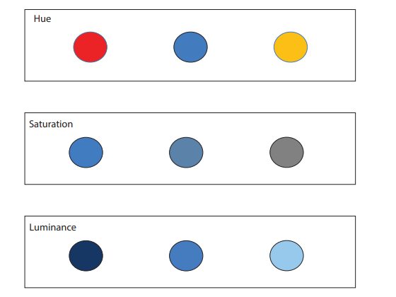
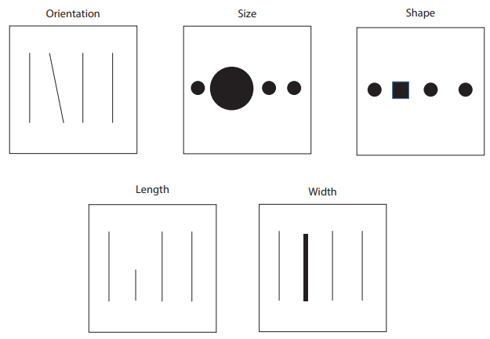
Preattentive attributes
Color attributes:
Hue (differs colors, the position the light occupies on the visible light spectrum)
Saturation (intensity of the color, the amount of gray in the color)
Luminance (amount of black versus white)
Position
Form
orientation
size
shape
length
width

Slide 4
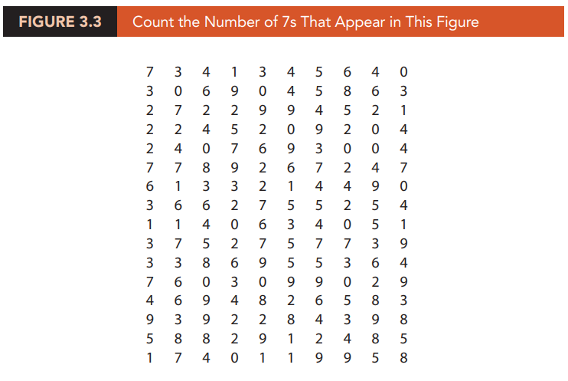
Preattentive attributes in data visualization

Slide 5
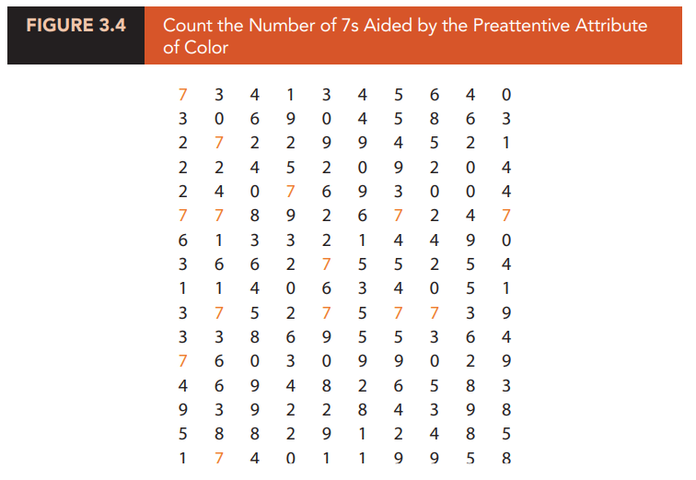
Preattentive attributes

Slide 6
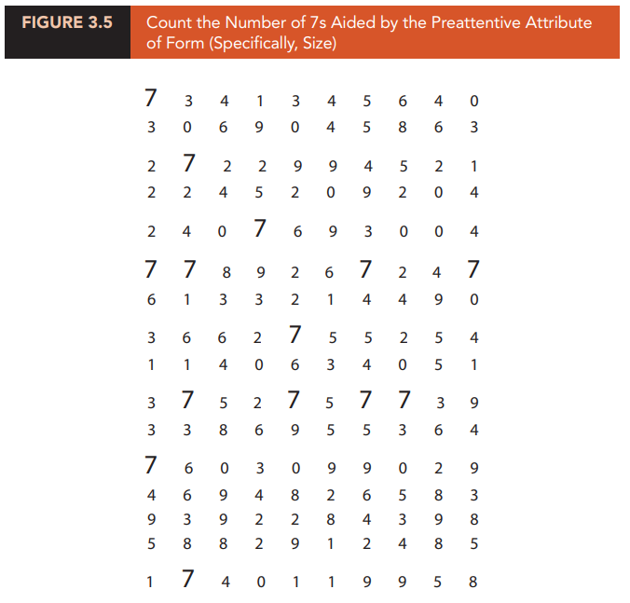

Slide 7
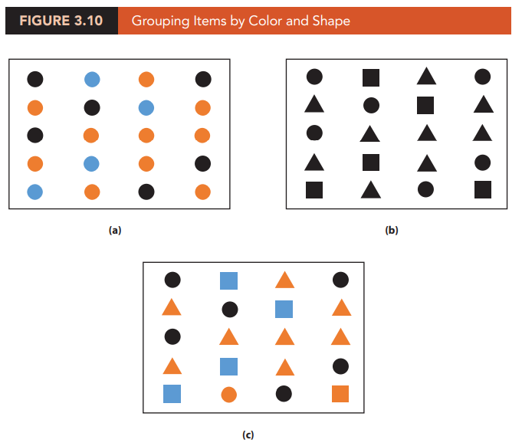

Slide 8
Gestalt Principles
Similarity (objects with similar characteristics belong to the same group)
Proximity (close to one another objects belong to the same group)
Enclosure (enclosed together objects belong to the same group)
Connection (connected objects belong to the same group)

Slide 9
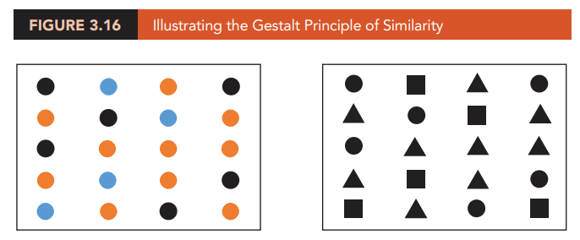
Gestalt Principles
Similarity (objects with similar characteristics belong to the same group)
characteristics could be
color, shape, size, orientation (any preattentive attribute)

Slide 10
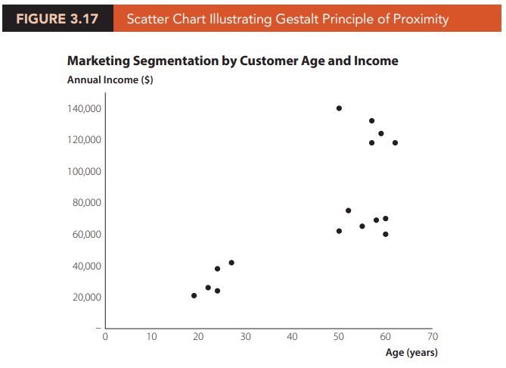
Gestalt Principles
Proximity (close to one another objects belong to the same group)

Slide 11
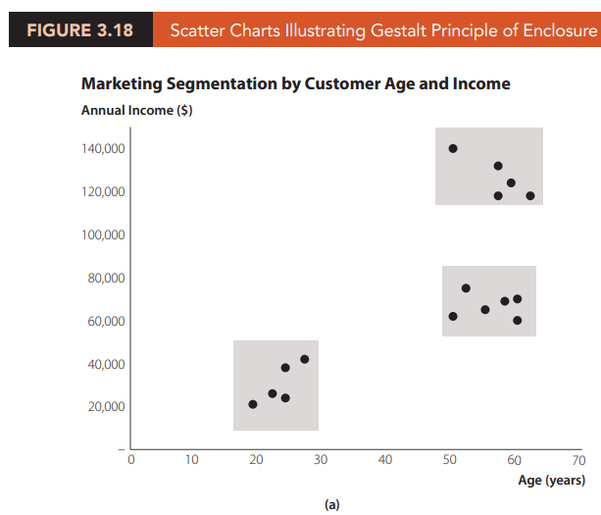
Gestalt Principles
Enclosure (enclosed together objects belong to the same group)

Slide 12
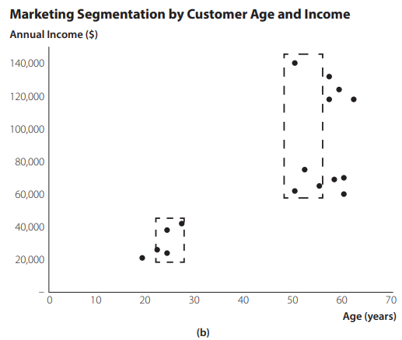
Gestalt Principles
Enclosure (enclosed together objects belong to the same group)

Slide 13
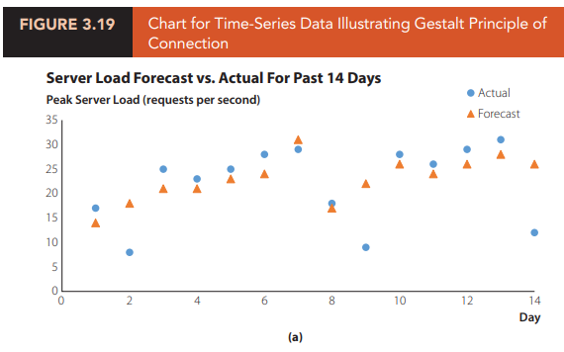
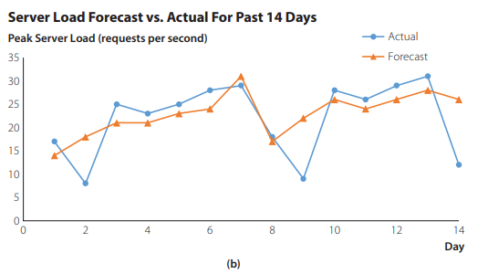
Gestalt Principles
Connection (connected objects belong to the same group)

Slide 14
Gestalt Principles
Connection (connected objects belong to the same group)

Slide 15
Ugly, Bad, and Wrong Figures
Ugly
A figure that has aesthetic problems but otherwise is clear and informative
Bad
A figure that has problems related to perception (unclear, confusing, overly complicated, or deceiving)
Wrong
A figure that has problems related to mathematics; it is objectively incorrect

Slide 16
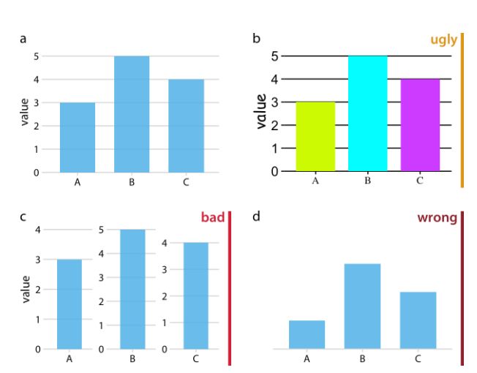
Ugly, Bad, and Wrong Figures

Slide 17
Scale

Slide 18
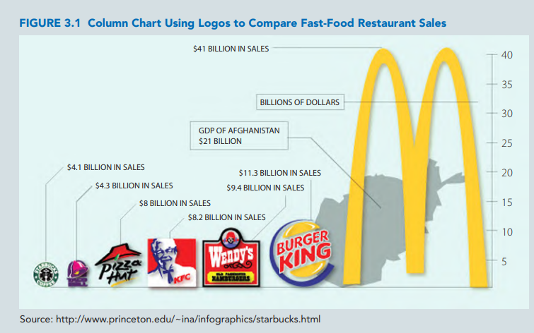
Care the scale

Slide 19
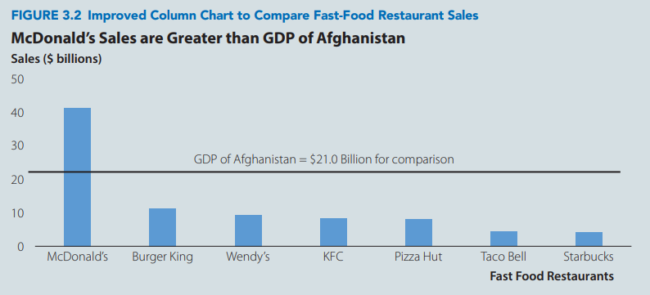
Care the scale

Slide 20
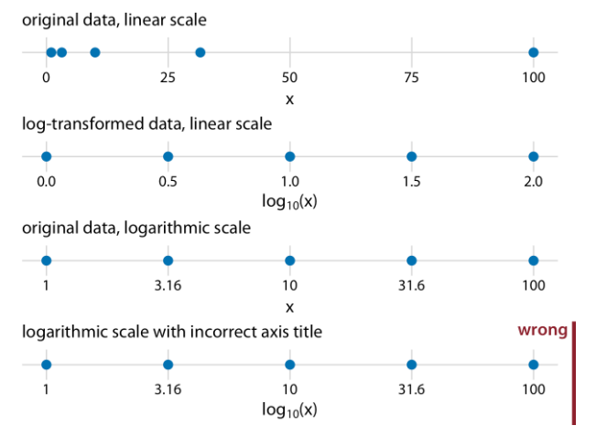
Care the scale

Slide 21
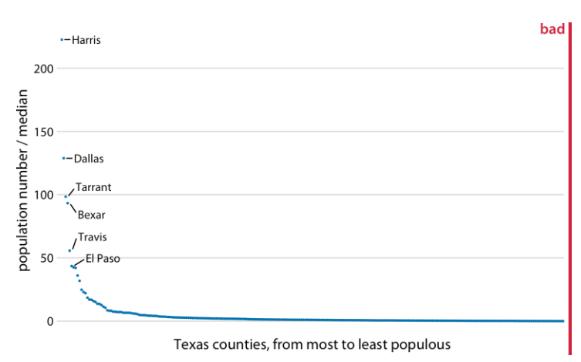
Care the scale

Slide 22
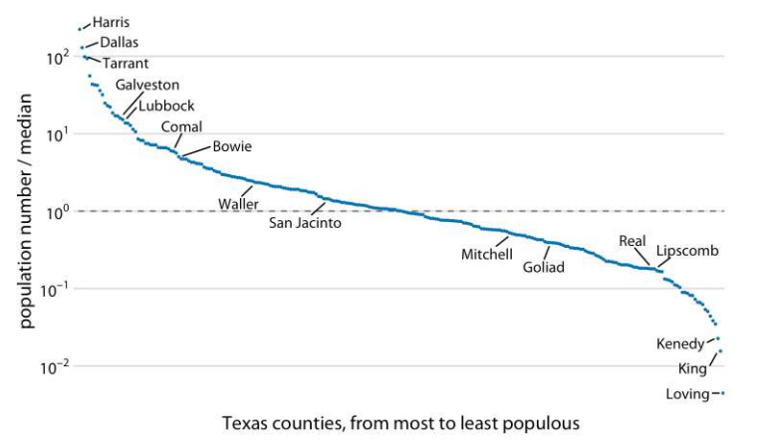
Care the scale

Slide 23
Coordinate Systems

Slide 24
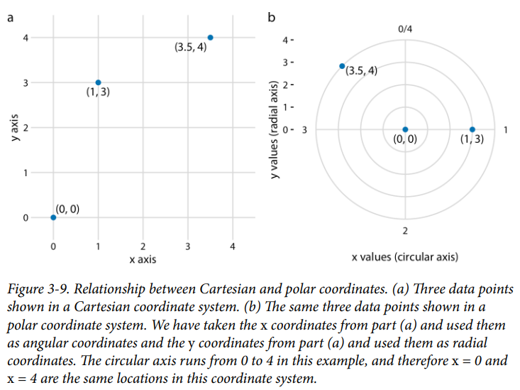
Coordinate Systems

Slide 25
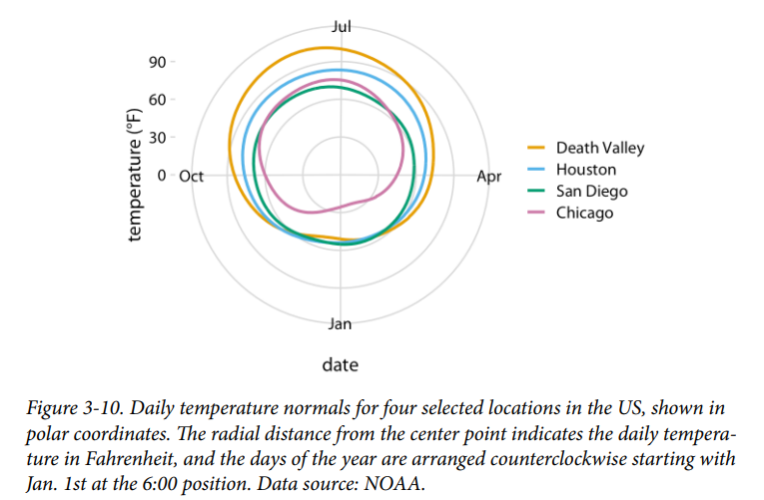
Coordinate Systems

Slide 26
Colors and color scales

Slide 27
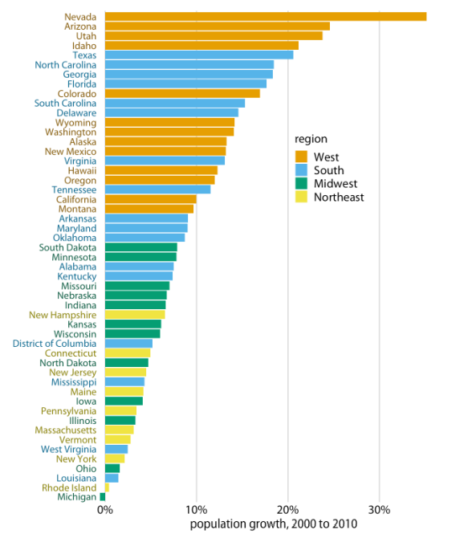
Color as a Tool to Distinguish

Slide 28
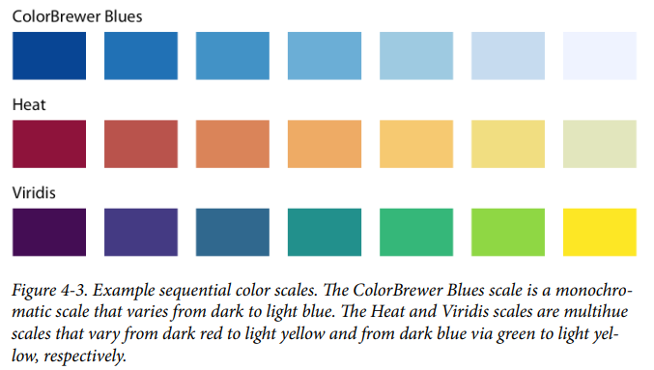
Colors and color scales

Slide 29
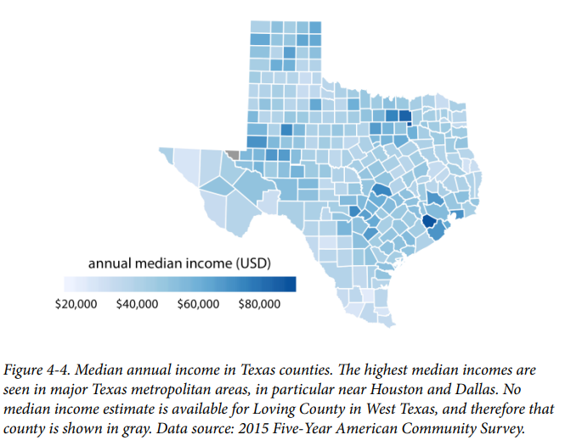
Colors and color scales

Slide 30
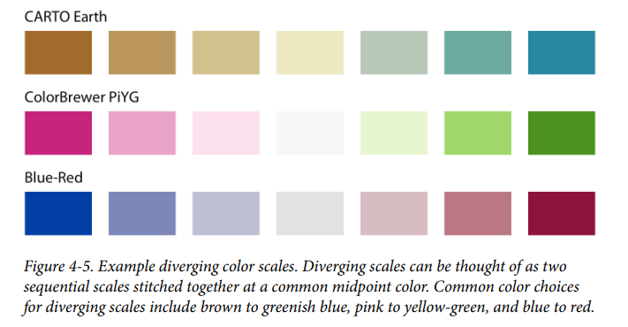
Colors and color scales

Slide 31
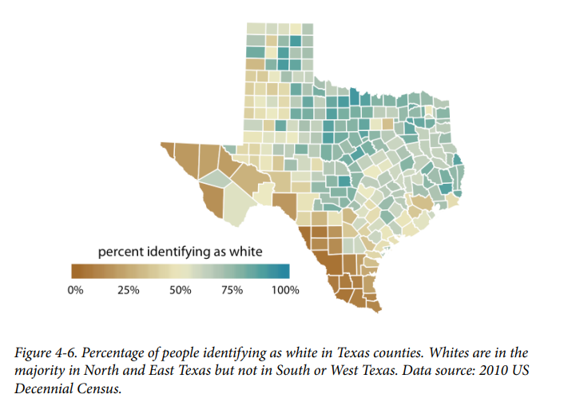
Colors and color scales

Slide 32
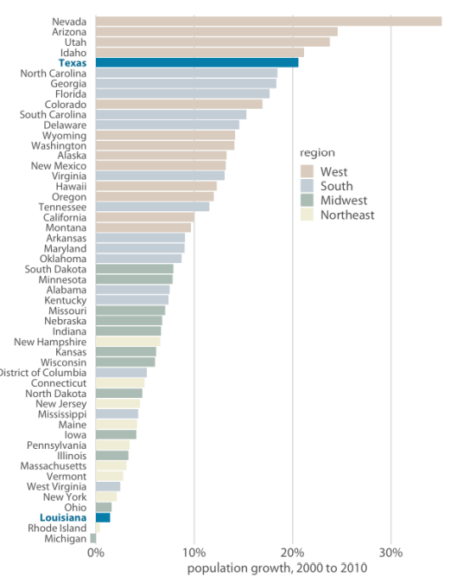
Color as a Tool to Highlight

Slide 33
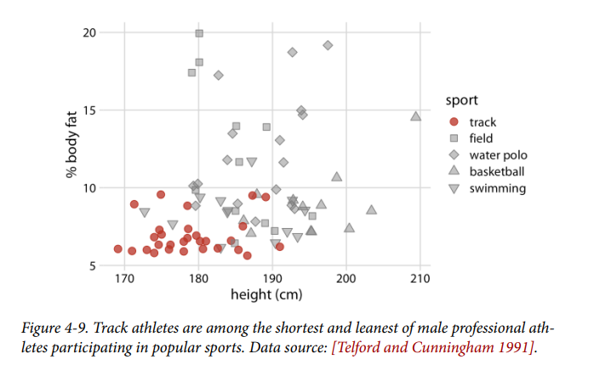
Colors and color scales

Slide 34
Common Mistakes in DV

Slide 35
Principles
Data-ink ratios (the idea of maximizing it) measures the proportion of “data-ink” to the total amount of ink used in a table or chart
principle of proportional ink [Bergstrom and West 2016]:
When a shaded region is used to represent a numerical value, the area of that shaded region should be directly proportional to the corresponding value.

Slide 36
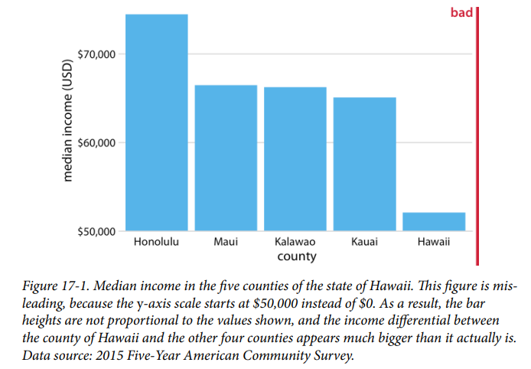

Slide 37
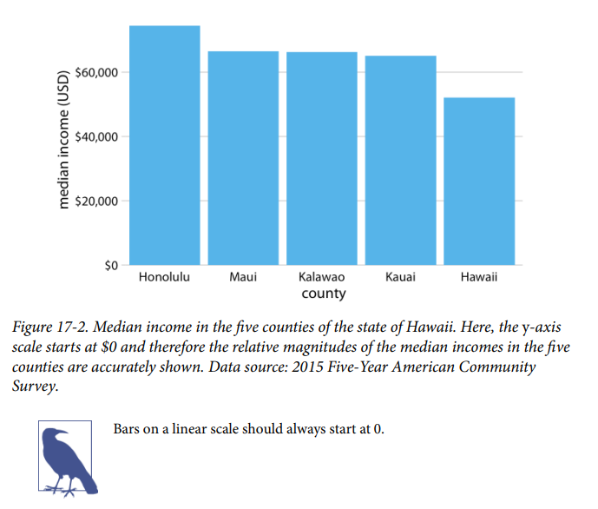

Slide 38
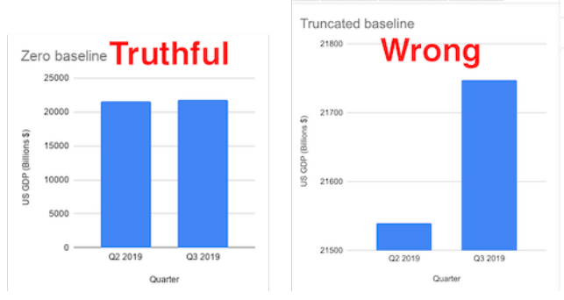

Slide 39
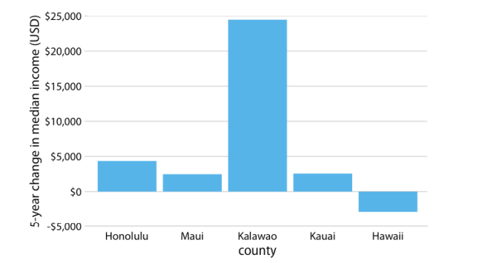
It is perfectly valid to use bars or shaded areas to show differences between conditions, as long as we make it explicit which differences we are showing

Slide 40
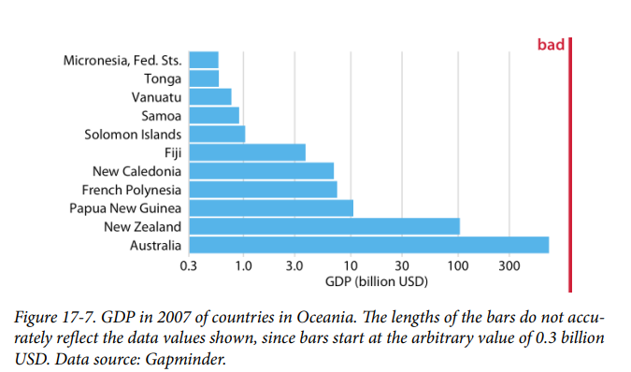
Common Mistakes in DV

Slide 41
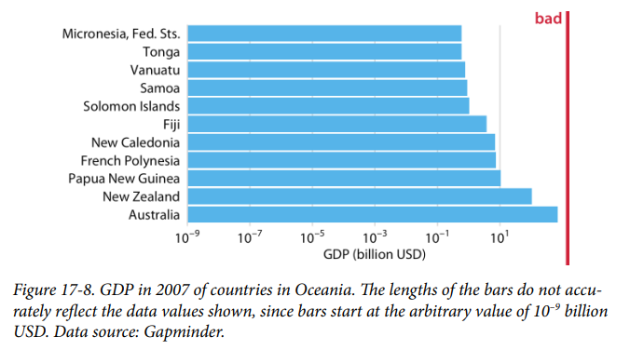
Common Mistakes in DV

Slide 42
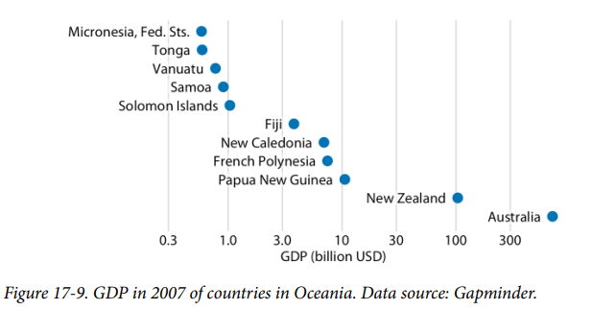
Common Mistakes in DV
Bars could be inappropriate

Slide 43
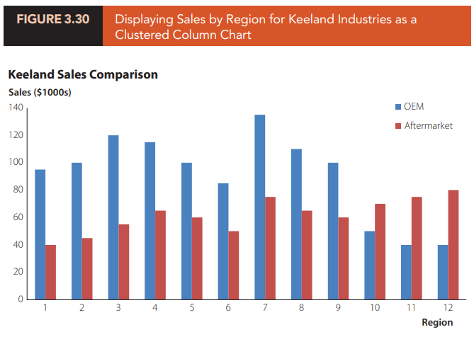
Common Mistakes in DV
Wrong chart or trying to Display Too Much Information

Slide 44
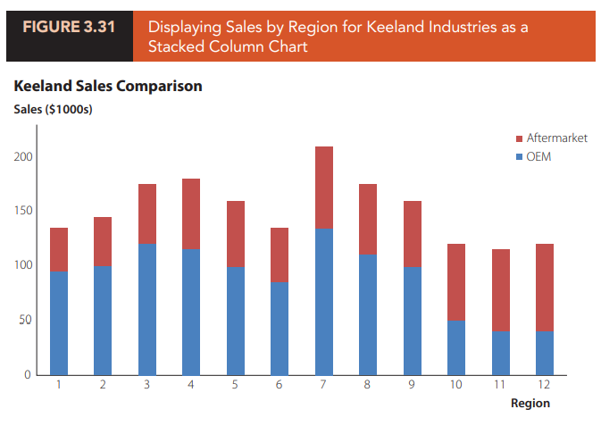
Common Mistakes in DV

Slide 45
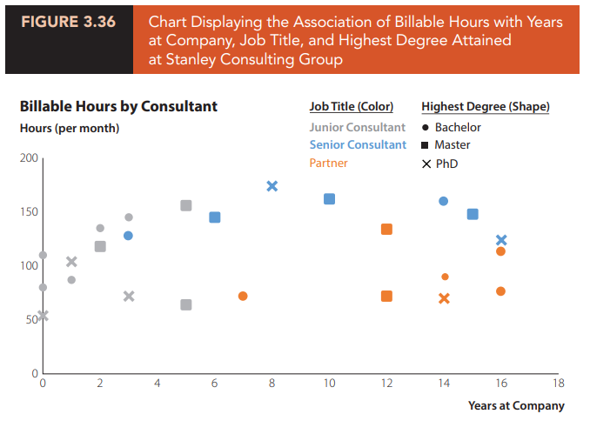
Common Mistakes in DV
Trying to Display Too Much Information (Too Many Attributes)

Slide 46
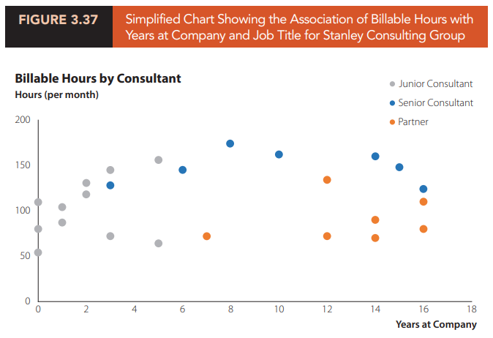
Common Mistakes in DV
Trying to Display Too Much Information (Too Many Attributes)

Slide 47
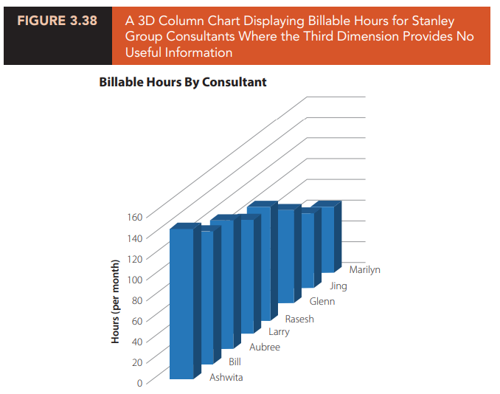
Common Mistakes in DV
Unnecessary Use of 3D

Slide 48
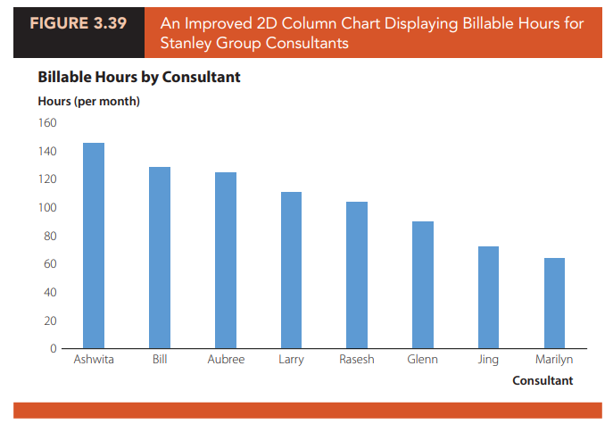
Common Mistakes in DV
Unnecessary Use of 3D

Slide 49
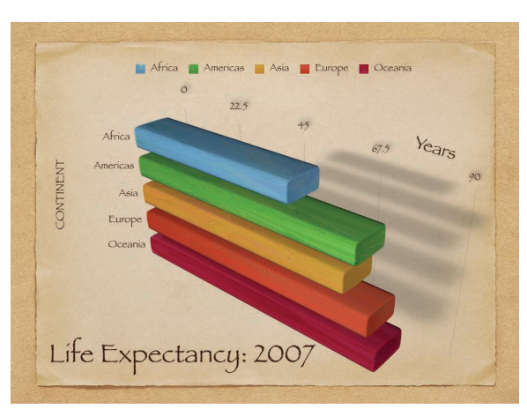
Common Mistakes in DV
A chart with a considerable amount of junk in it

Slide 50
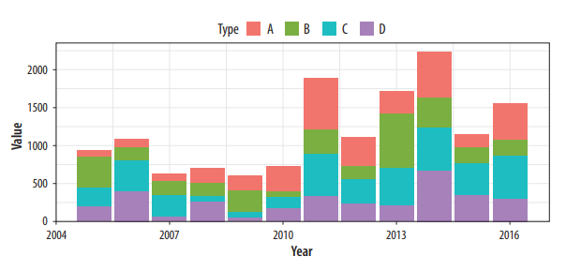
Common Mistakes in DV
Hard to interpret

Slide 51
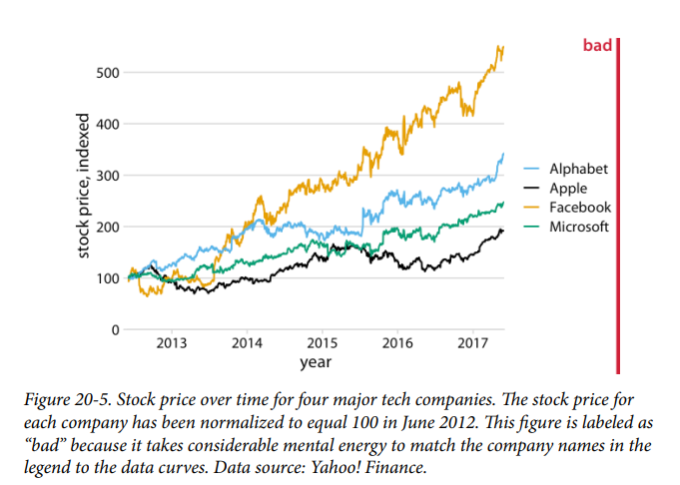
Common Mistakes in DV

Slide 52
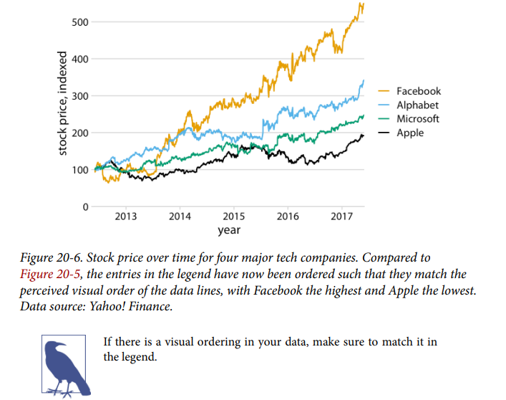
Common Mistakes in DV

Slide 53
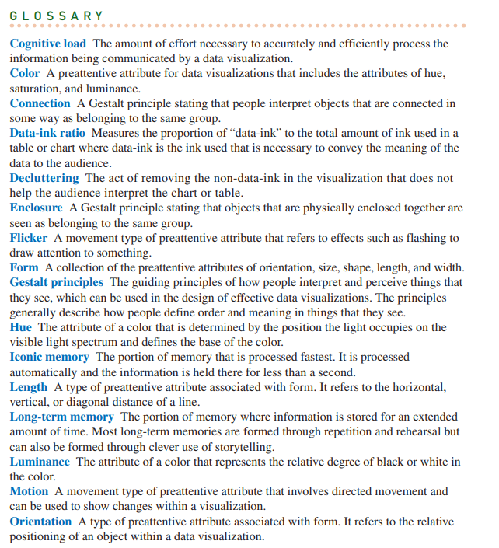

Slide 54
